Slide 1
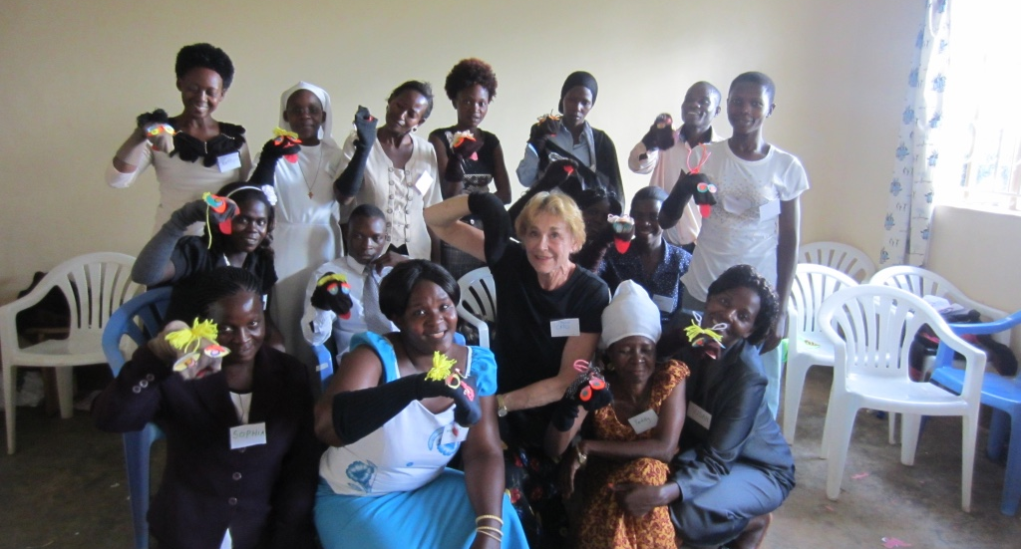
Carol Sterling
Adventures in Educational Puppetry

Slide 2
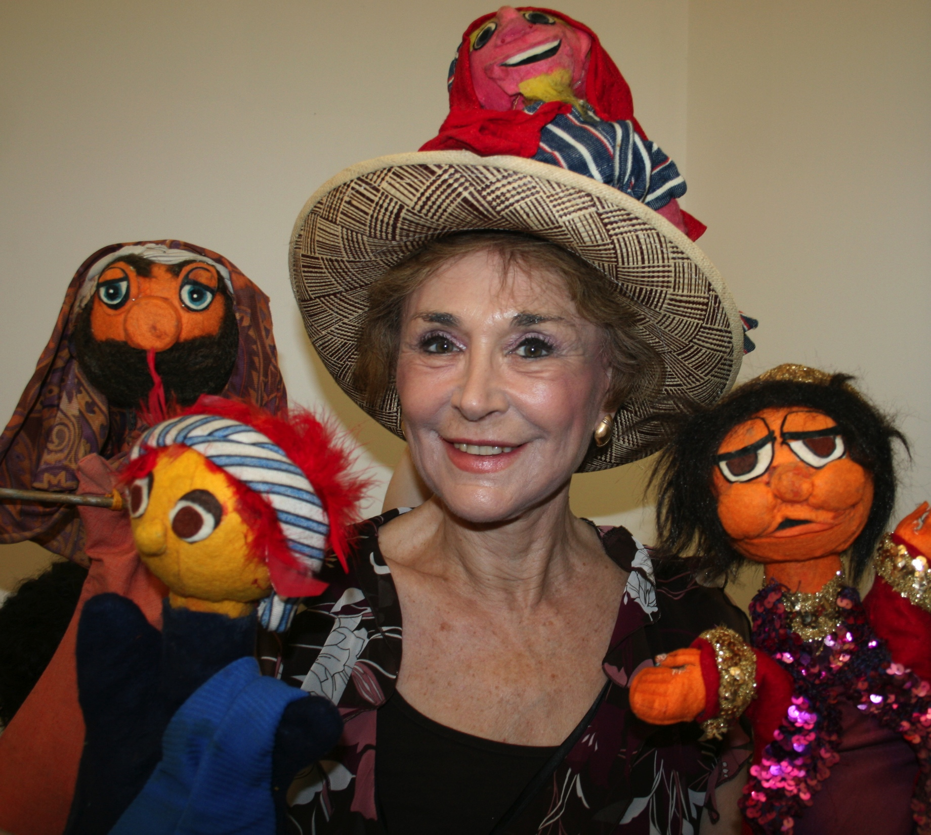
Carol Sterling
Carol Sterling’s work as an educational puppeteer has focused on integrating puppetry into the elementary and high school curriculum. She works in schools and colleges of education, and conducts professional development programs for teachers, parents and librarians, as well as workshops for young people.

Slide 3
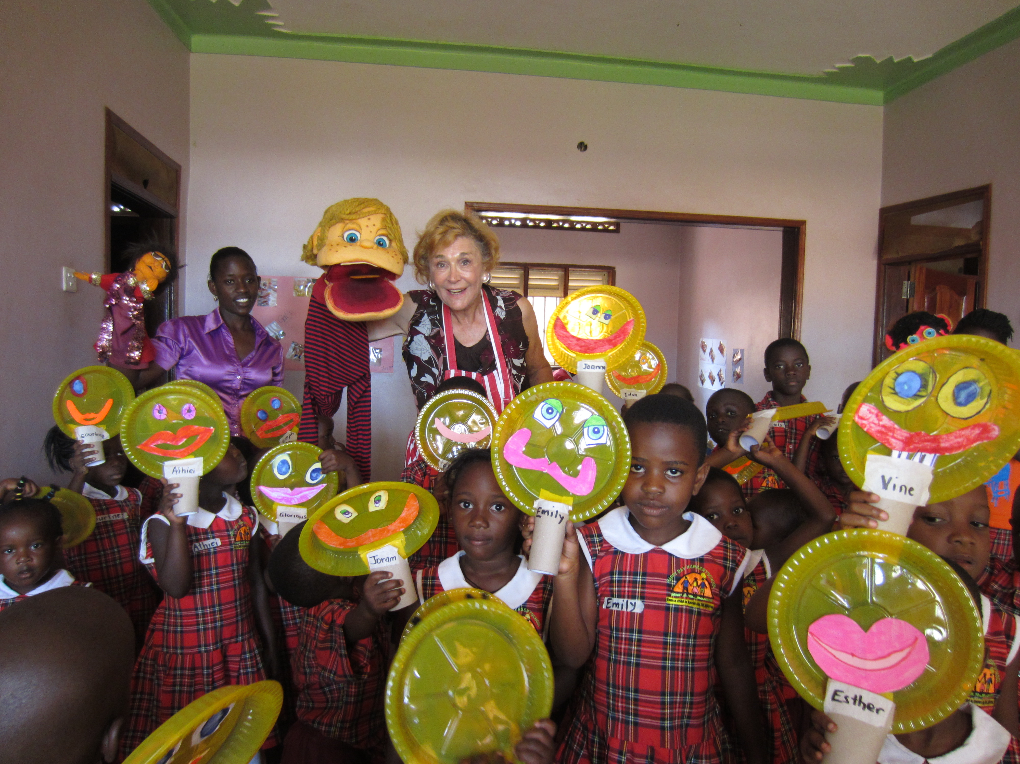
Teaching Early Childhood Grades

Slide 4
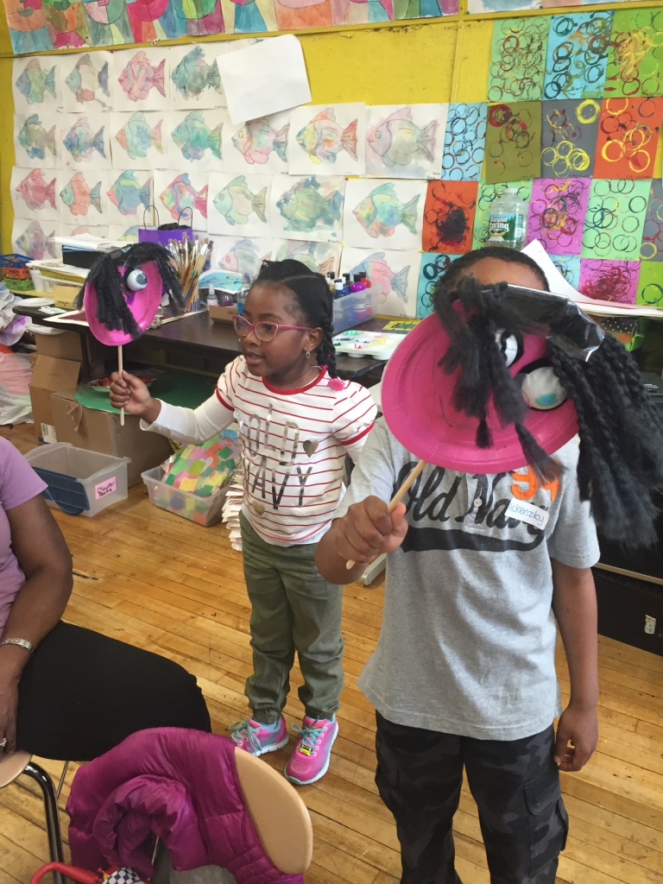

Slide 5
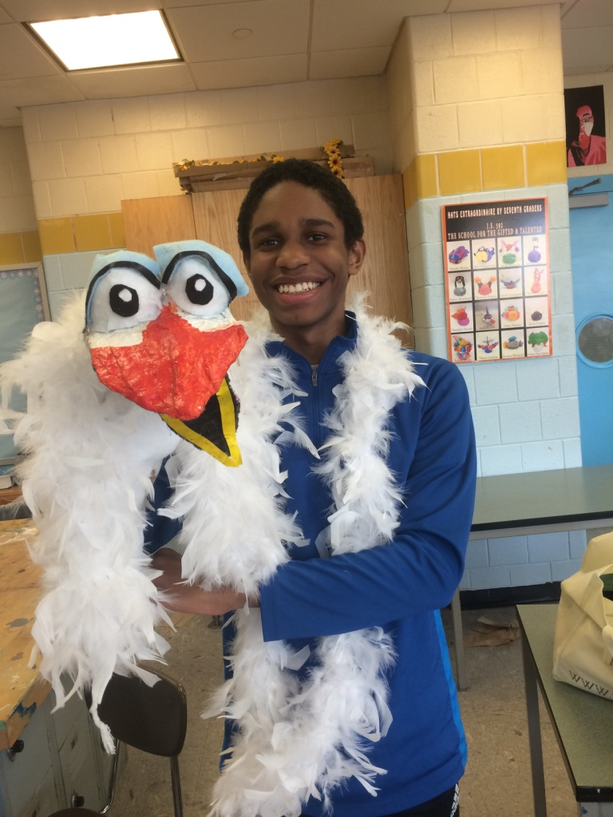
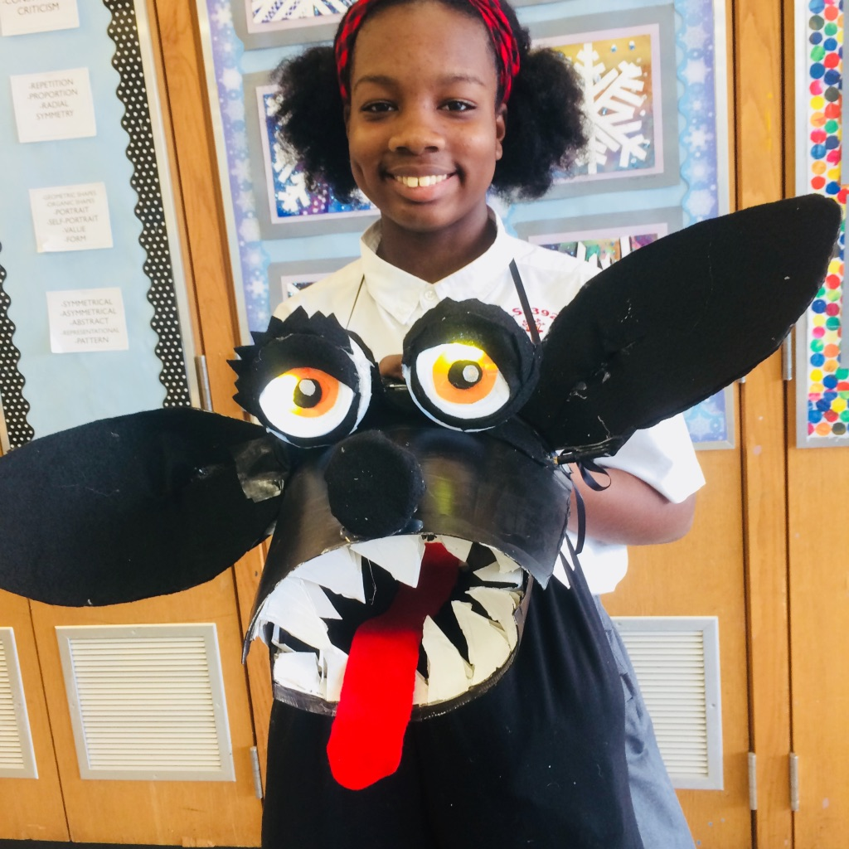
Teaching Middle School

Slide 6
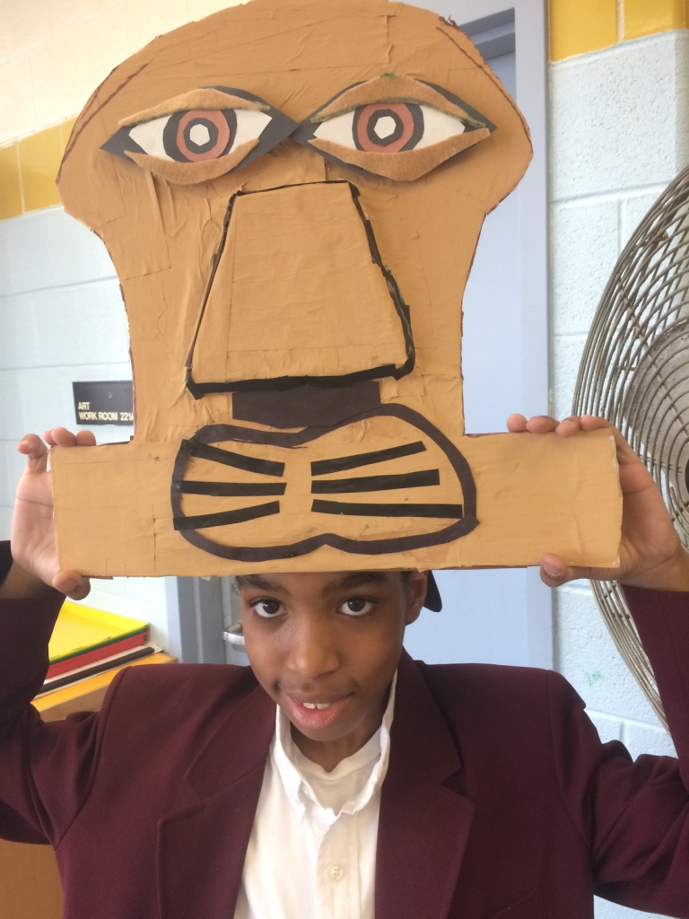
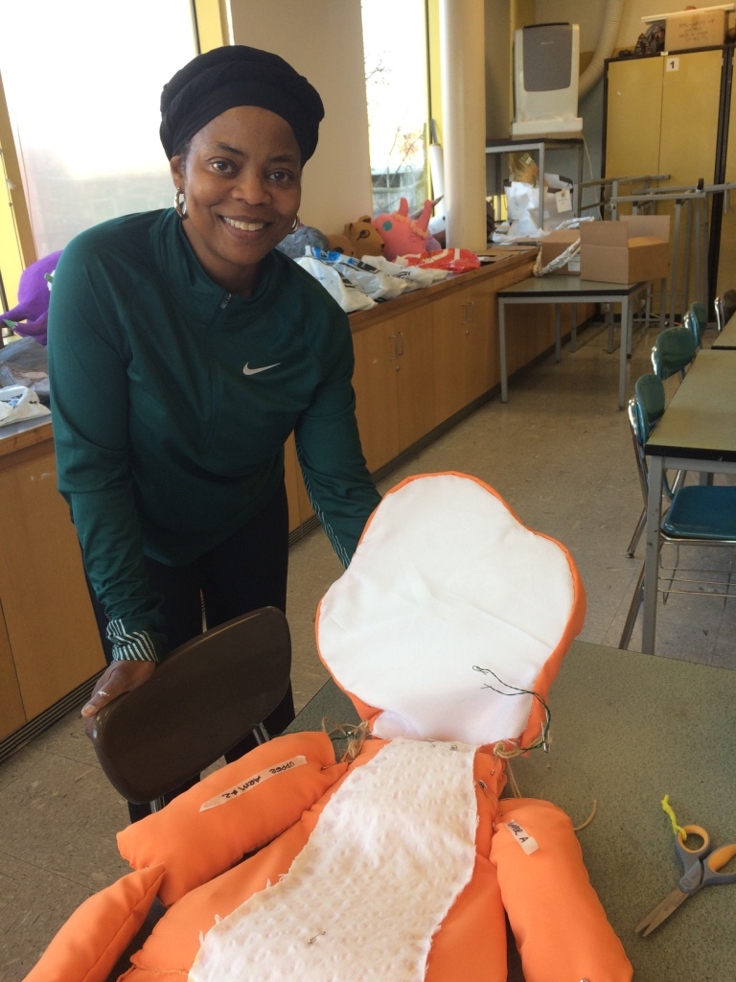
The Lion King Junior

Slide 7
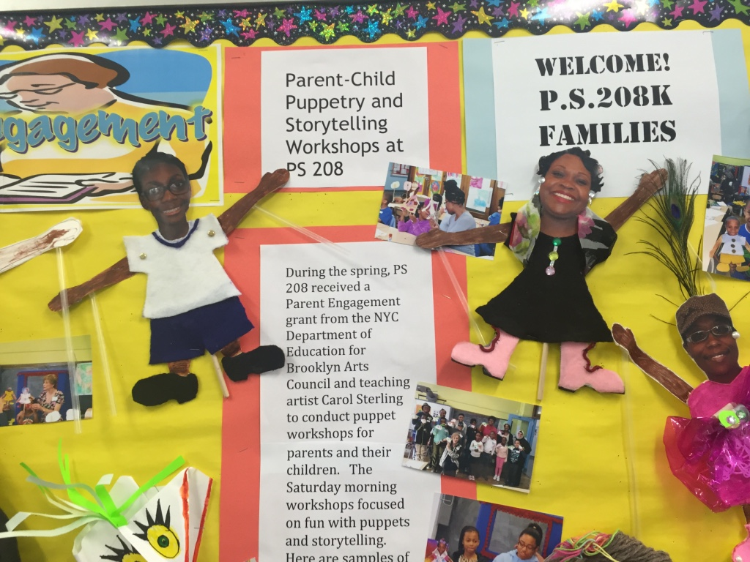
Publicizing the puppetry program

Slide 8
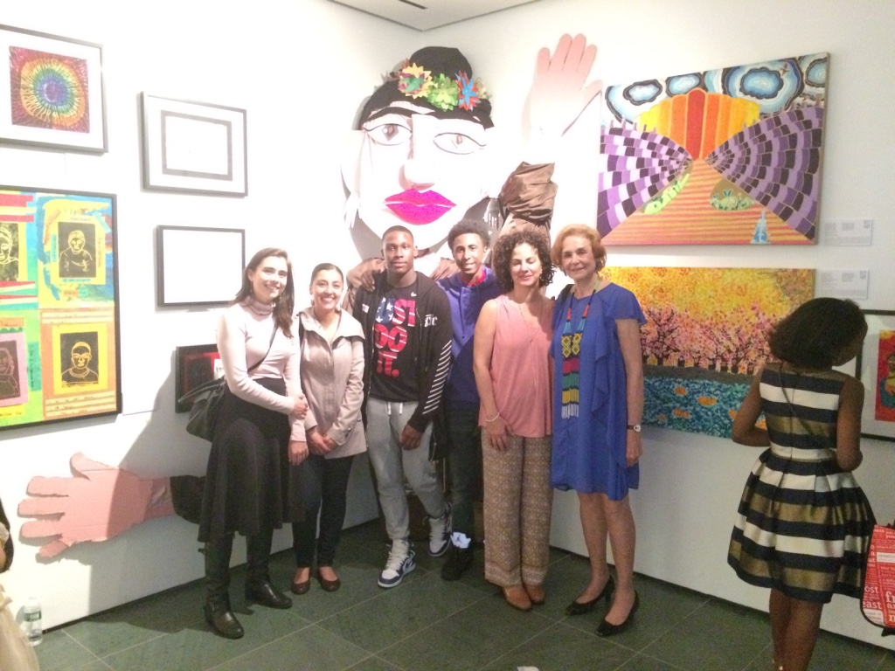
Teaching High School

Slide 9
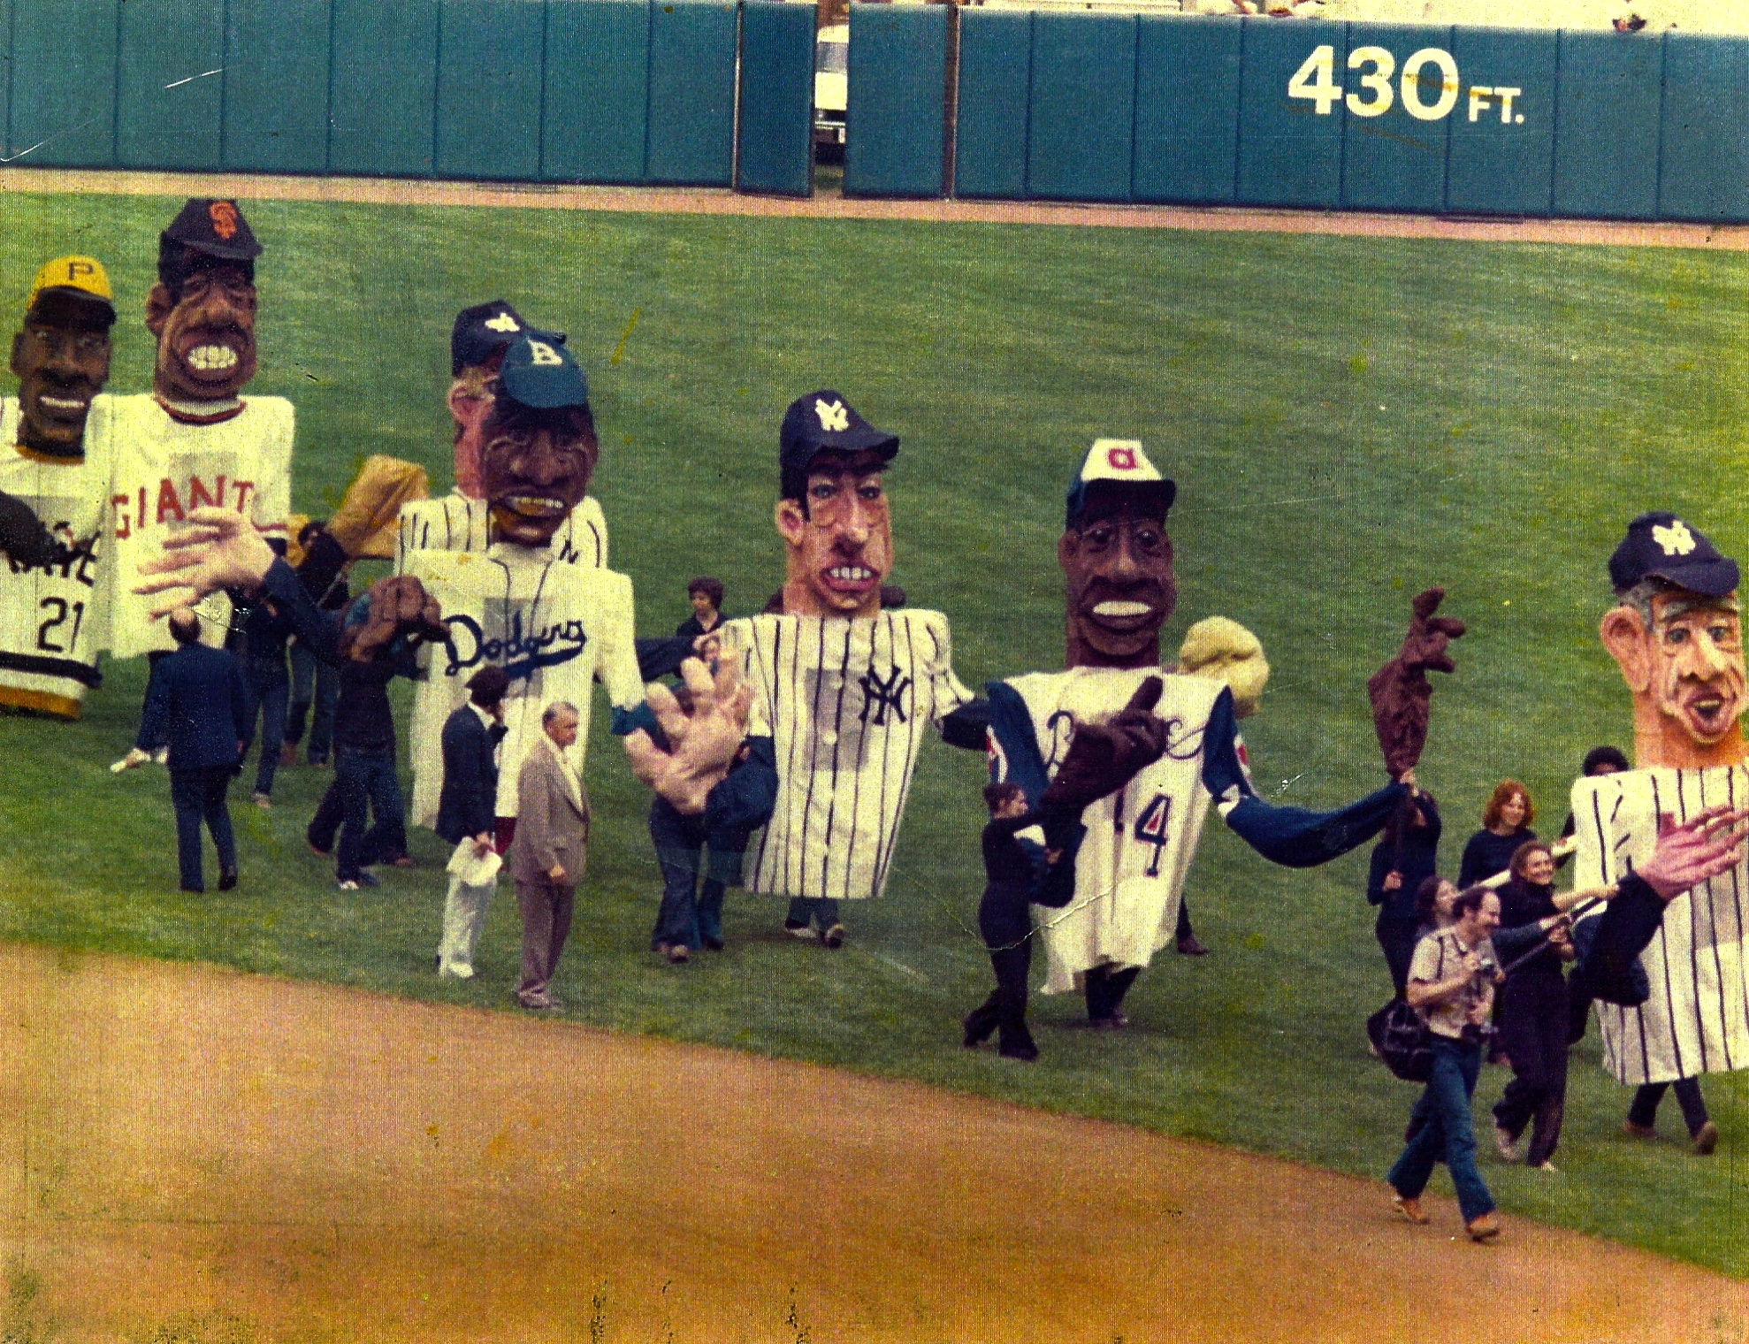
Baseball Heroes at Yankee Stadium

Slide 10
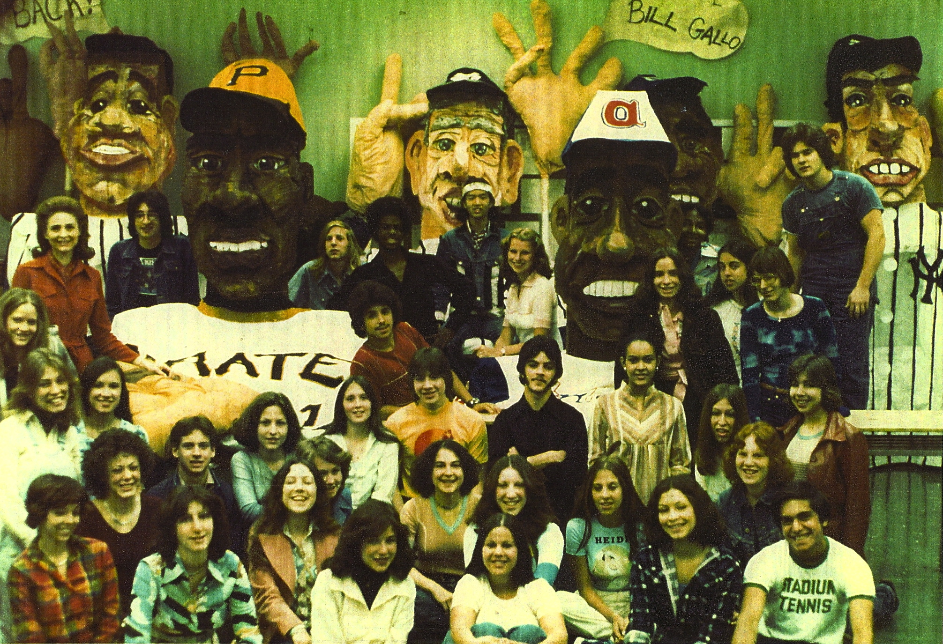
Here are the high school students who created the giant baseball puppets.

Slide 11
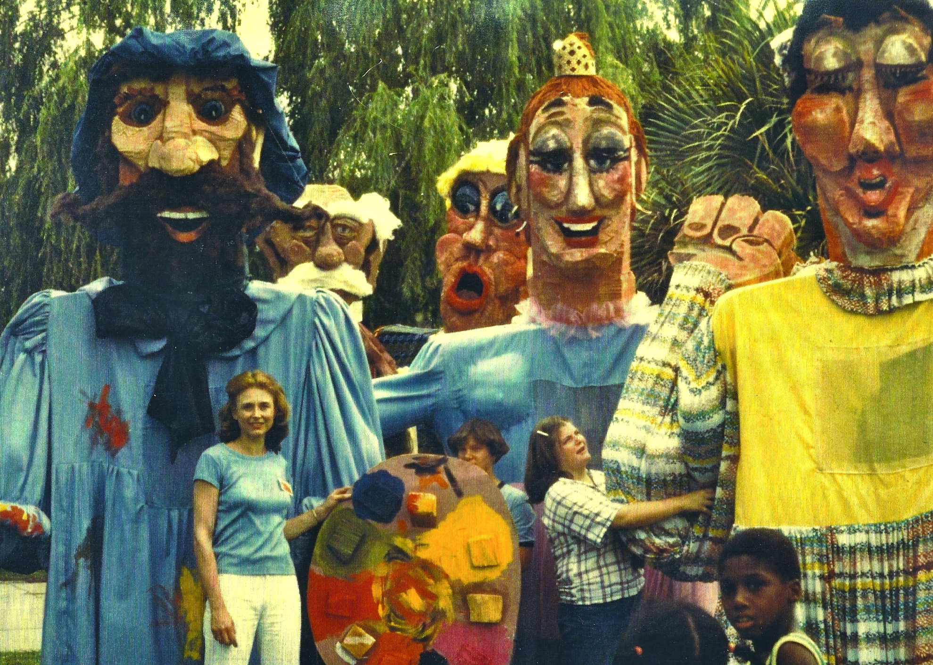
Carol Sterling with puppets representing the visual and performing arts, created under her direction by members of the community at the Spoleto Festival in Charleston, South Carolina, USA.

Slide 12
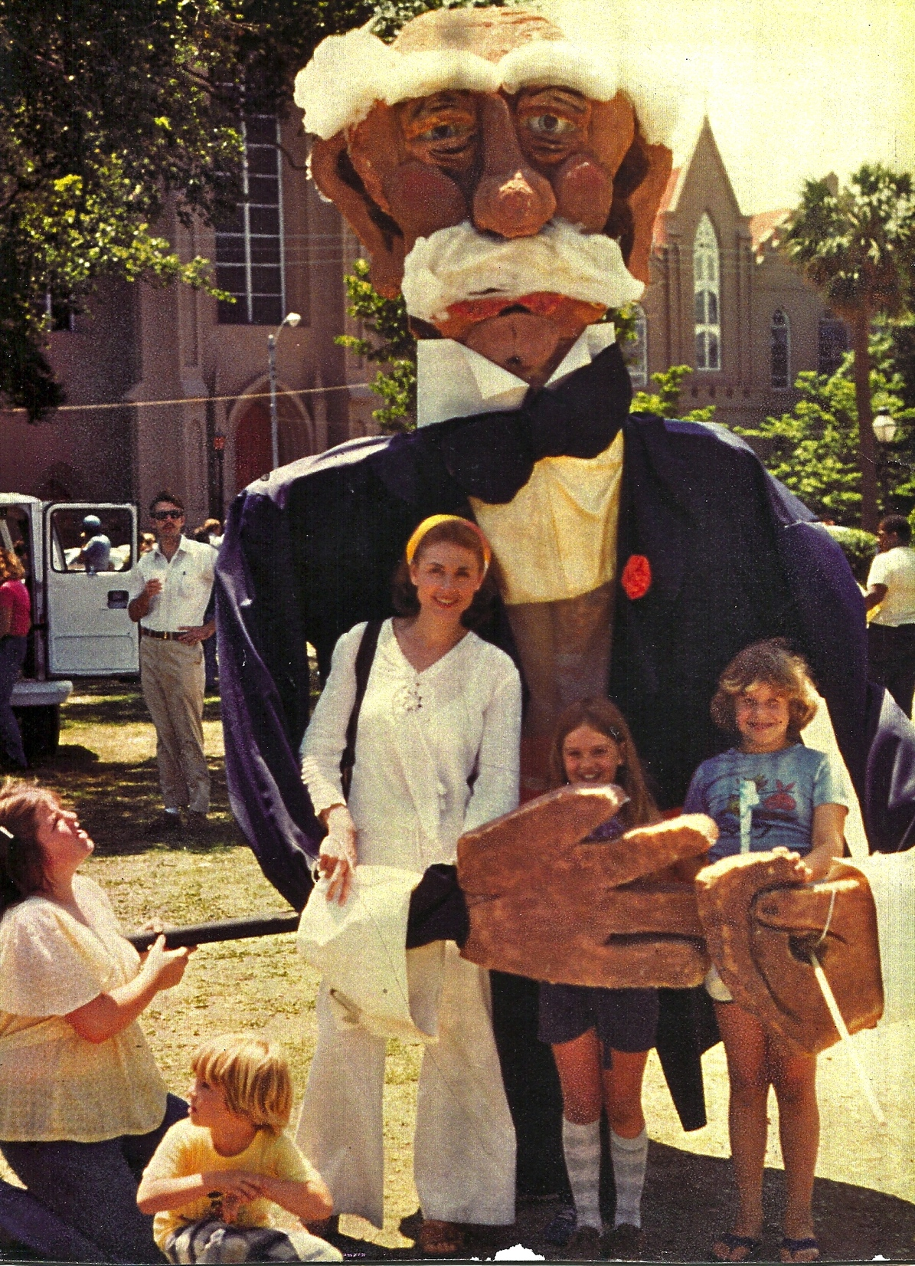
Here is Carol with giant puppet of a musical conductor at the Spoleto Festival in Charleston, South Carolina, USA.

Slide 13
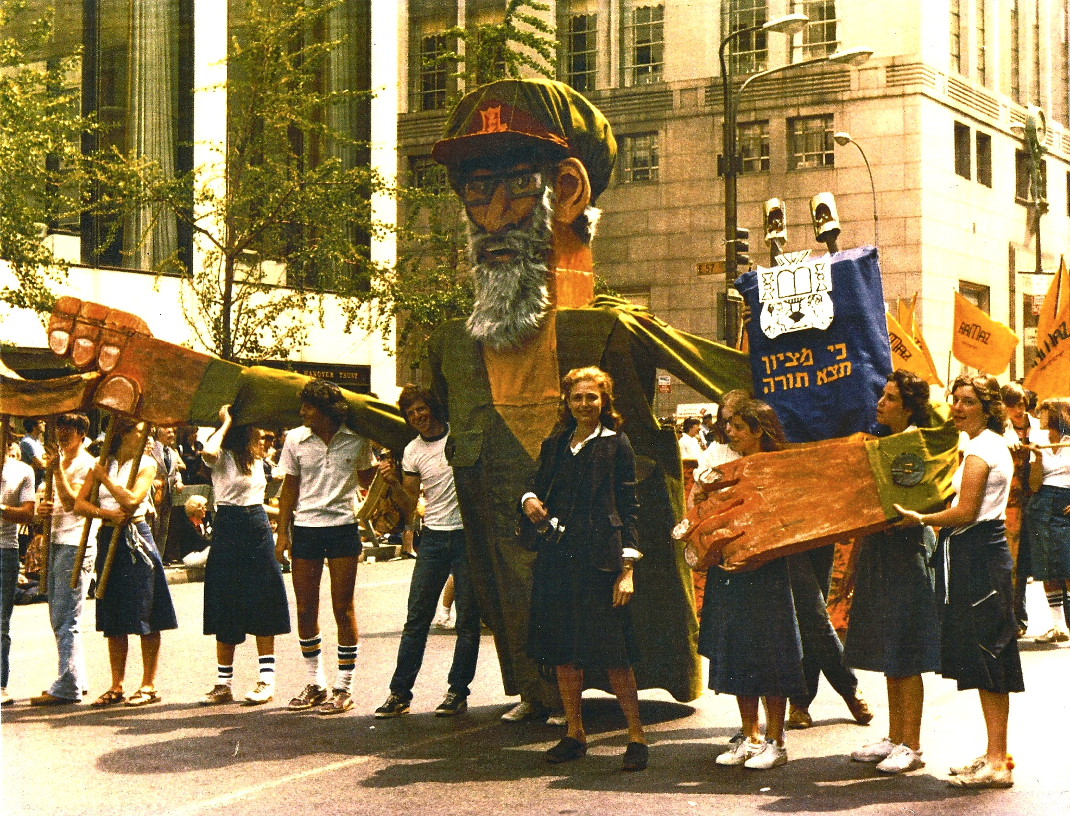
Carol Sterling with high school students at the Salute to Israel Parade in New York City, with a giant puppet of Rabbi Shlomo Goren.

Slide 14
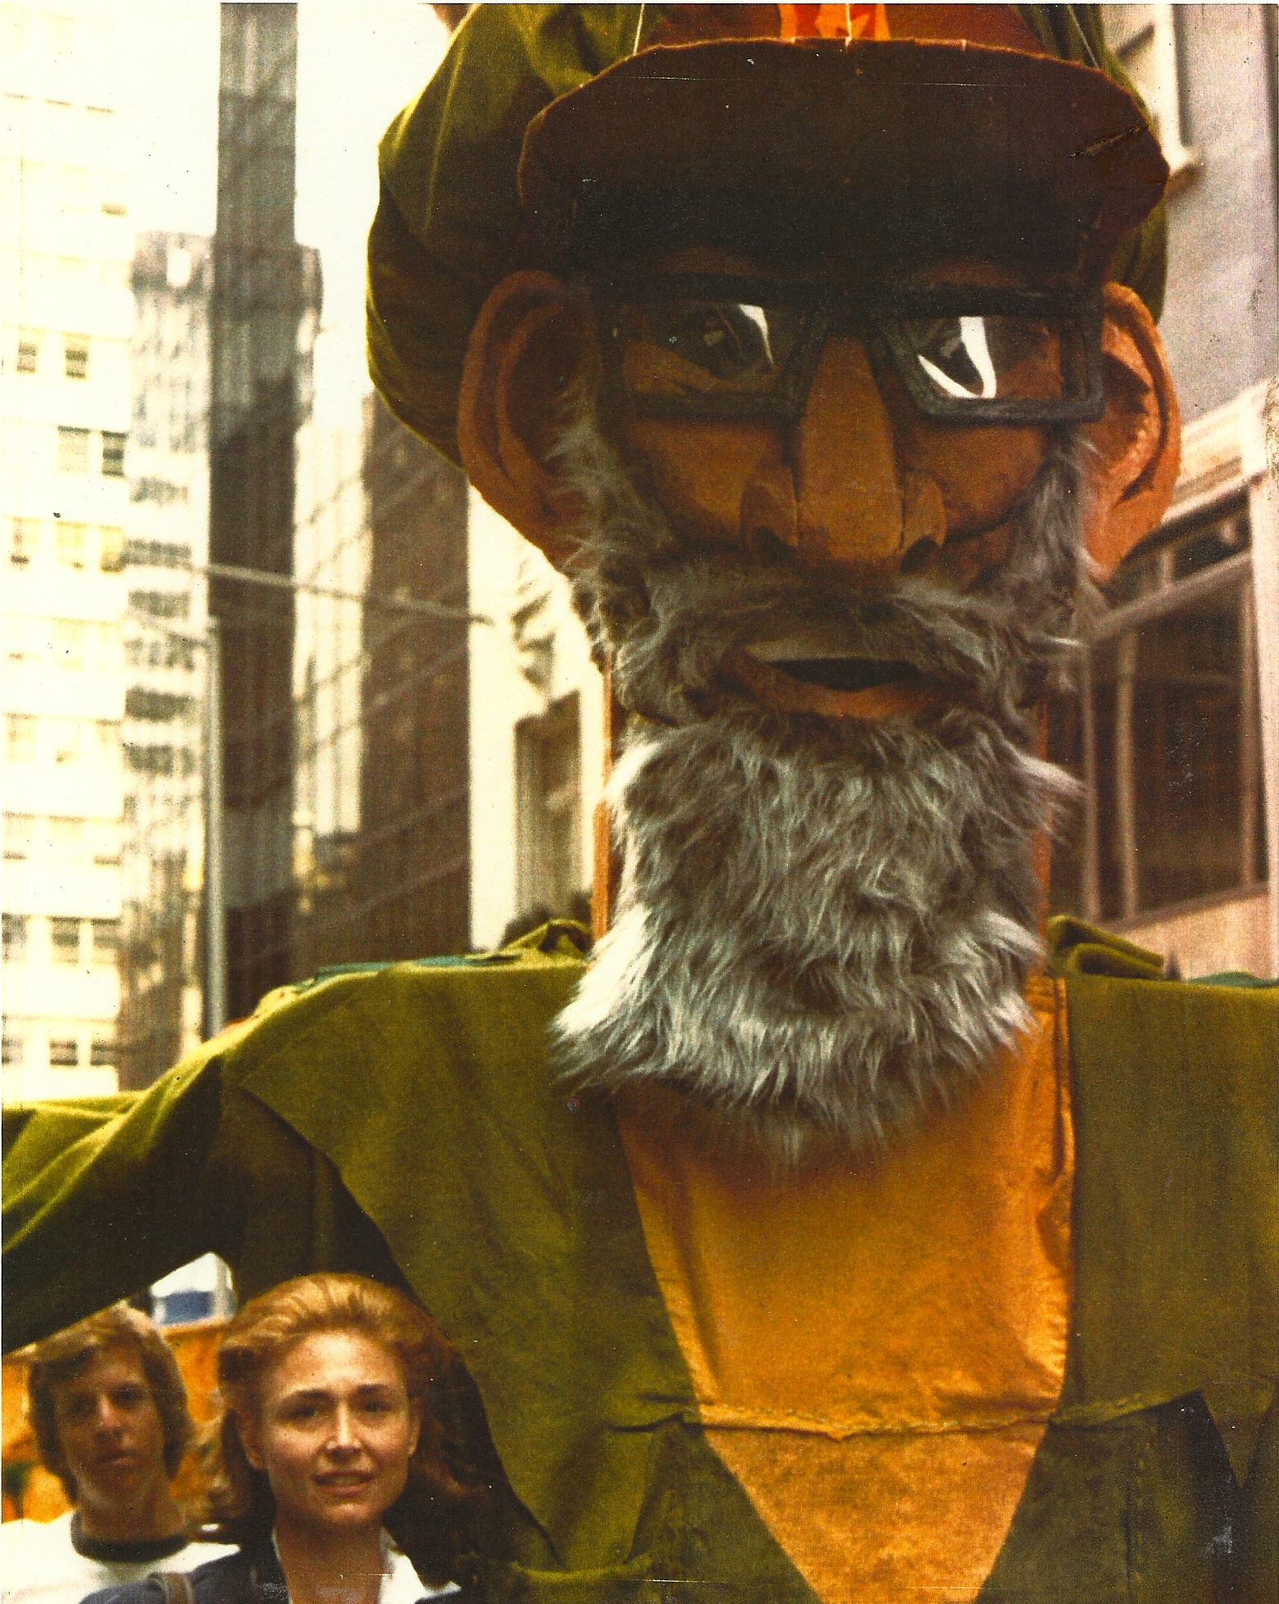
Carol Sterling with giant puppet at the Salute to Israel Parade. The puppet’s head, shoulders and hands were made from foam rubber. Each puppet weighed 20 pounds, and was carried by three high school students.

Slide 15
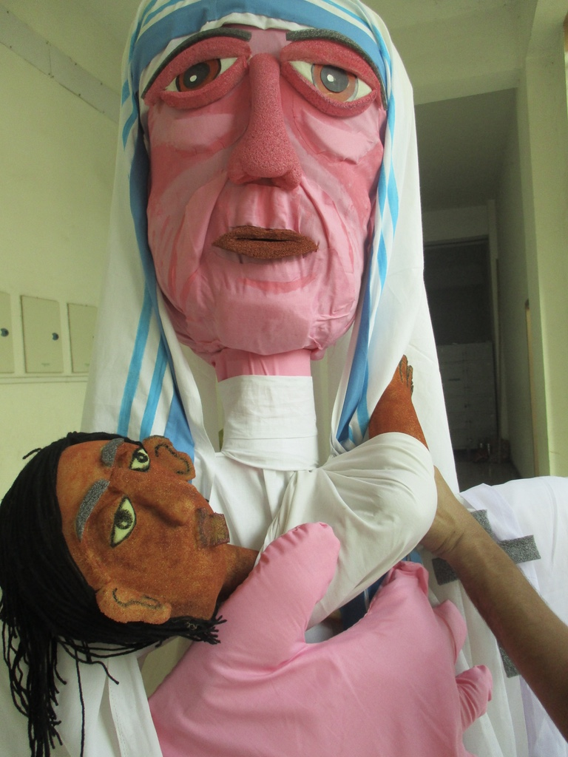
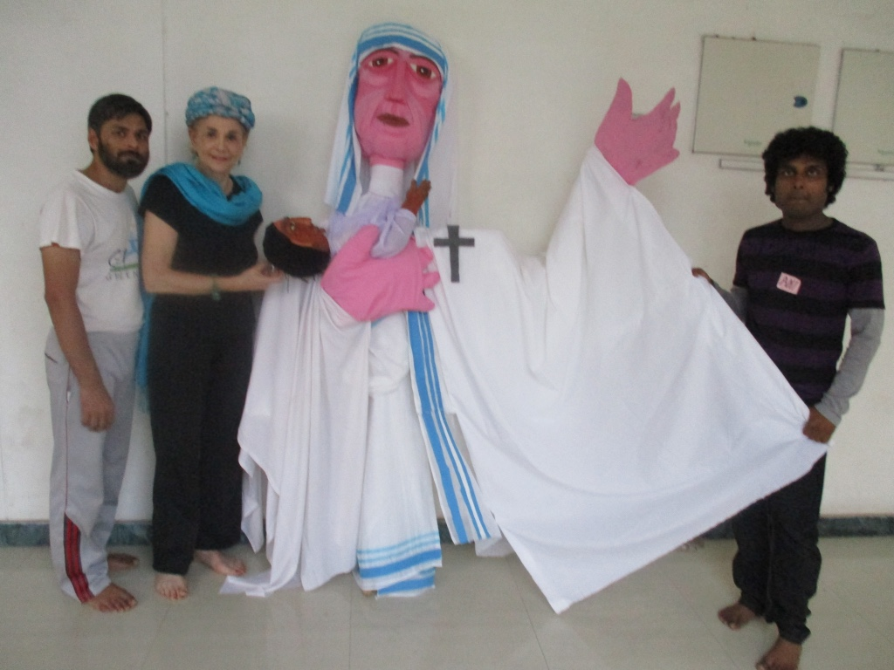
Historical puppets - Mother Theresa in India

Slide 16
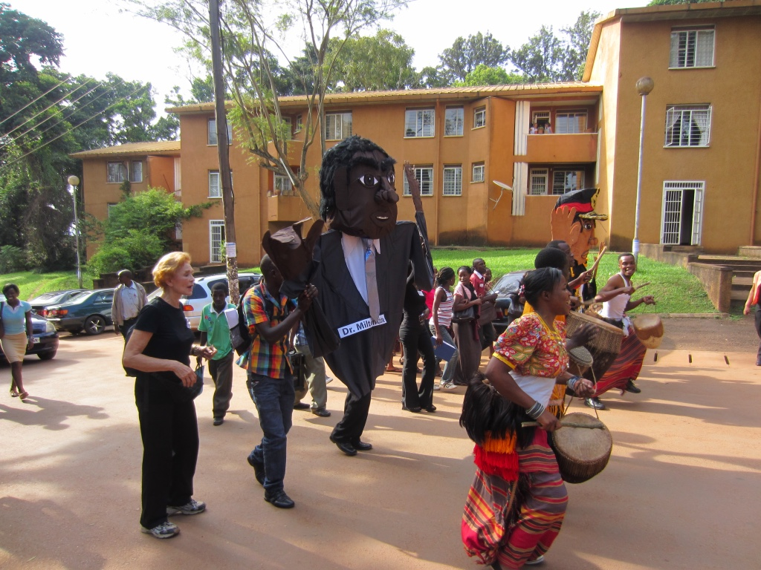
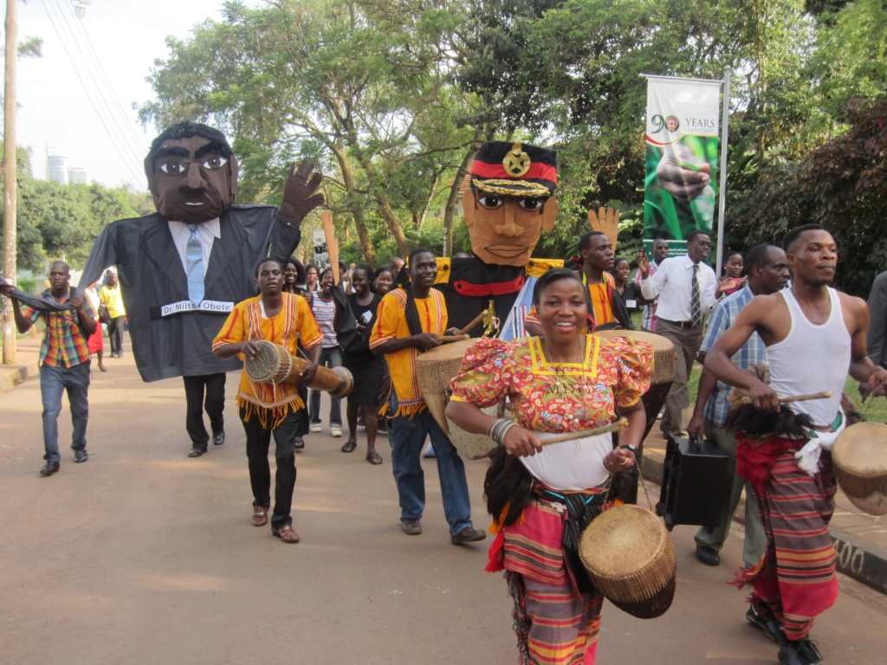
Giant Puppets made by in-service teachers in Uganda

Slide 17
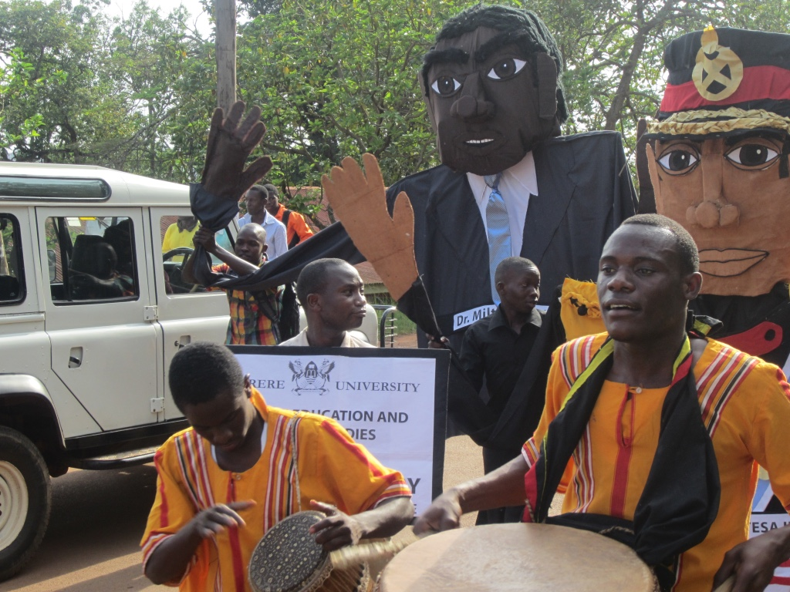
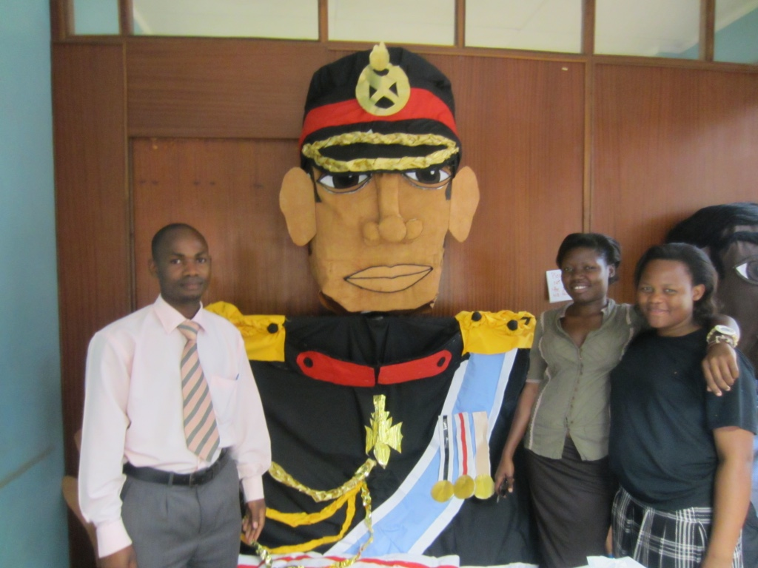

Slide 18
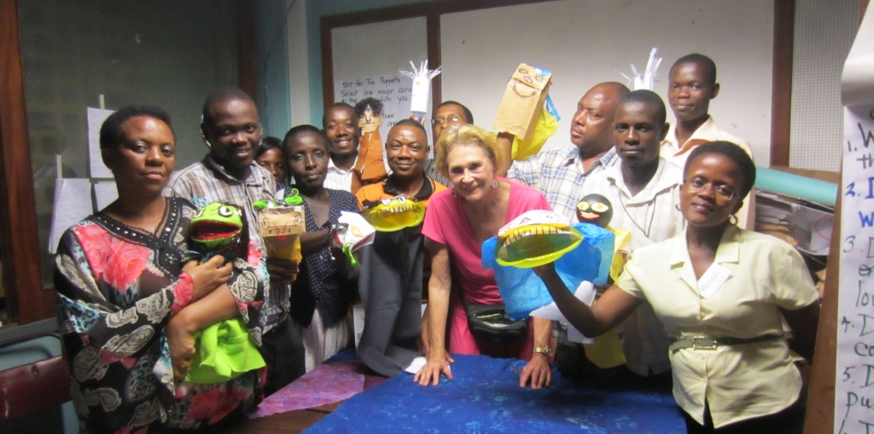
Teaching pre- and in-service teachers

Slide 19
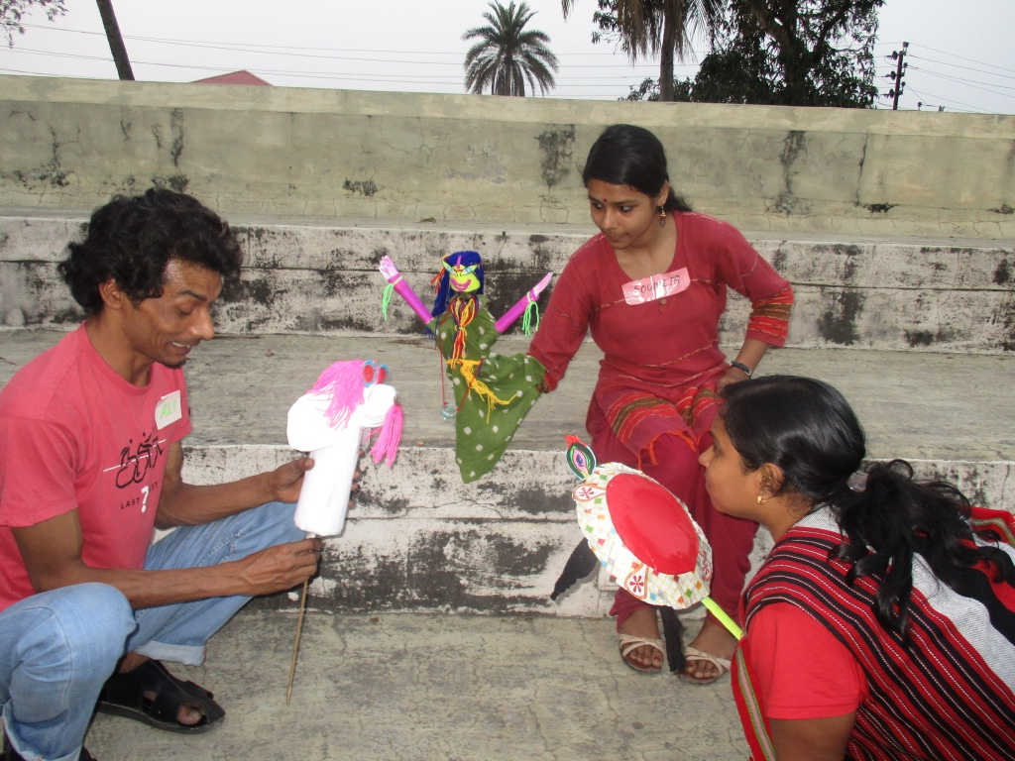
Learning to collaborate on a puppet skit

Slide 20
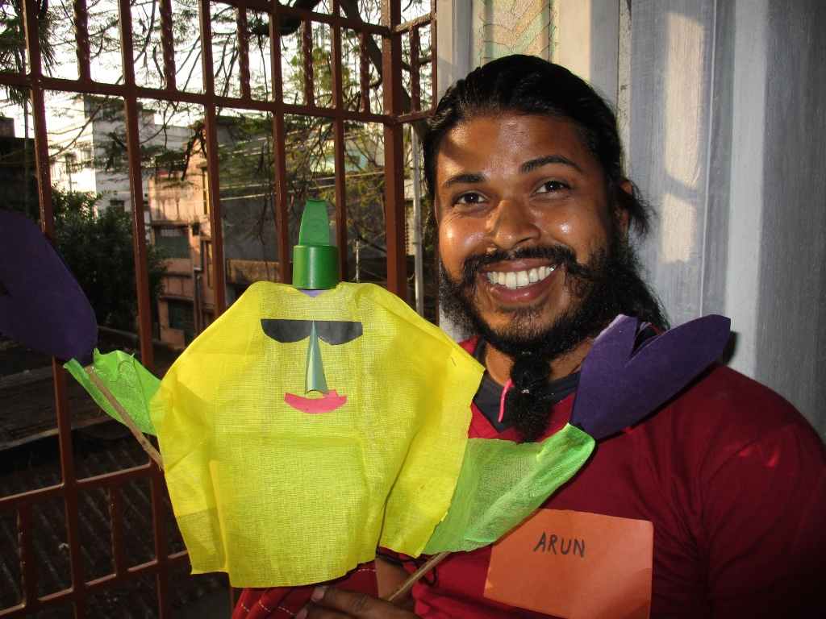
Teacher workshop using recycled materials

Slide 21
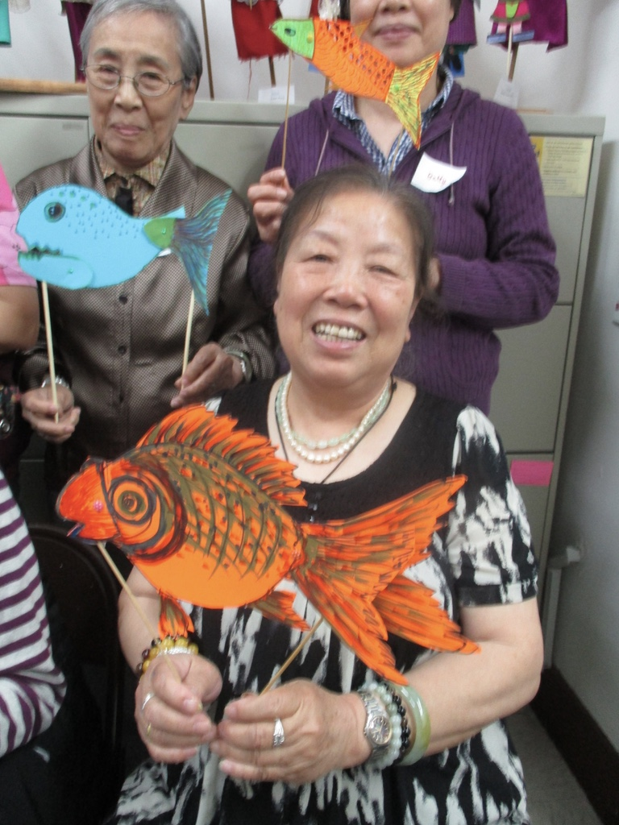
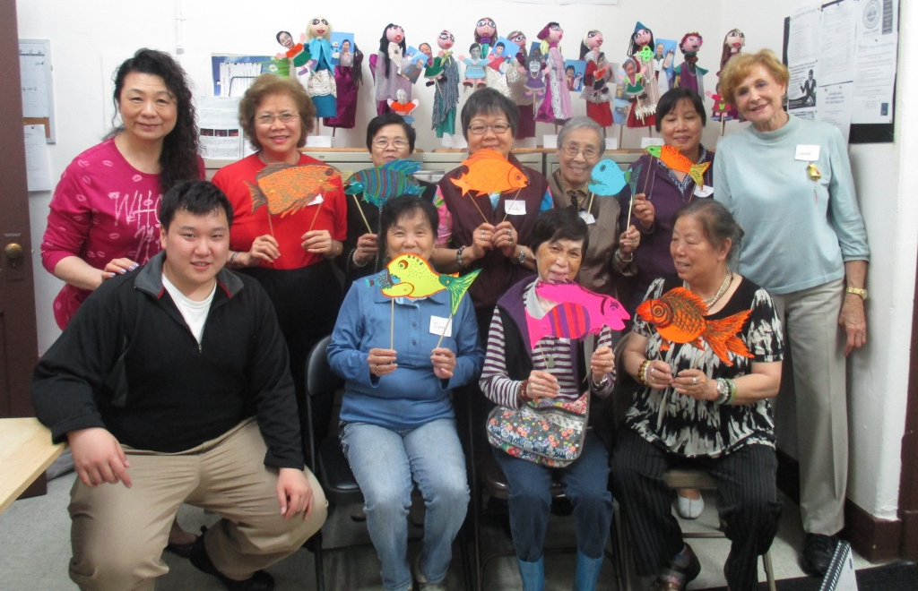
Teaching senior citizens in NYC Chinatown

Slide 22
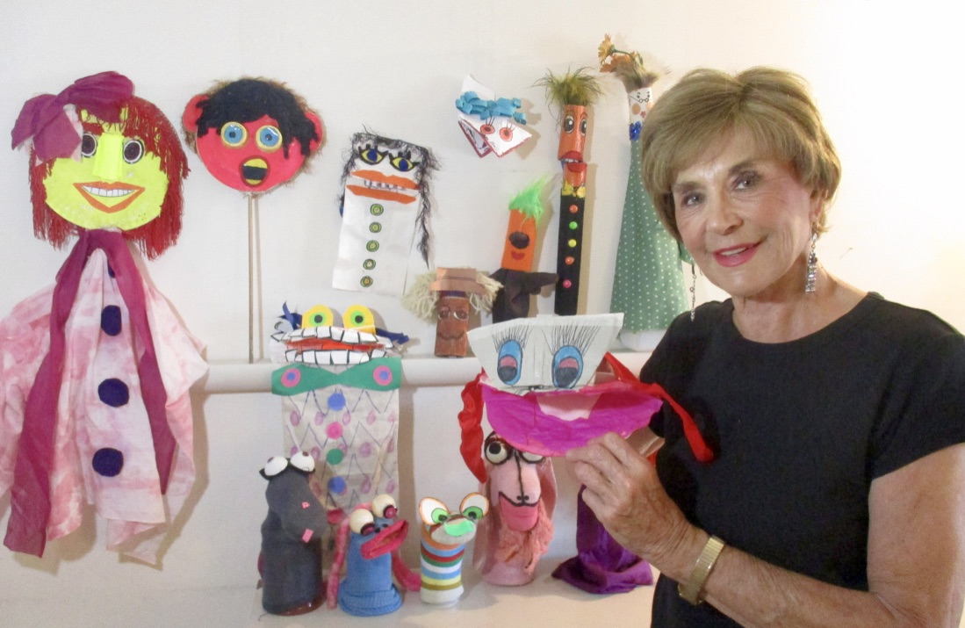
In conclusion, it is an honor to be an educational puppeteer and share my skills

